Slide 1

Listings123 Marketing Campaign
Gia Thurton
Name: ______________________
Exploratory Data Analysis

Slide 2
(What results did you reach?)
Listings123 needs to define data-based characteristics of a listing that make hosts successful in order to fund its marketing campaign to expand to other cities.
The achieve this, I framed the business problem, prepared and cleaned the data collected from 5551 listings, and performed exploratory data analysis to draw insights on what specific traits make Listings123 hosts successful.
Based on my EDA, I recommend that Listings123 hosts provide a variety of amenities, a real bed, and the entire home/apt. for their listings.

Slide 3
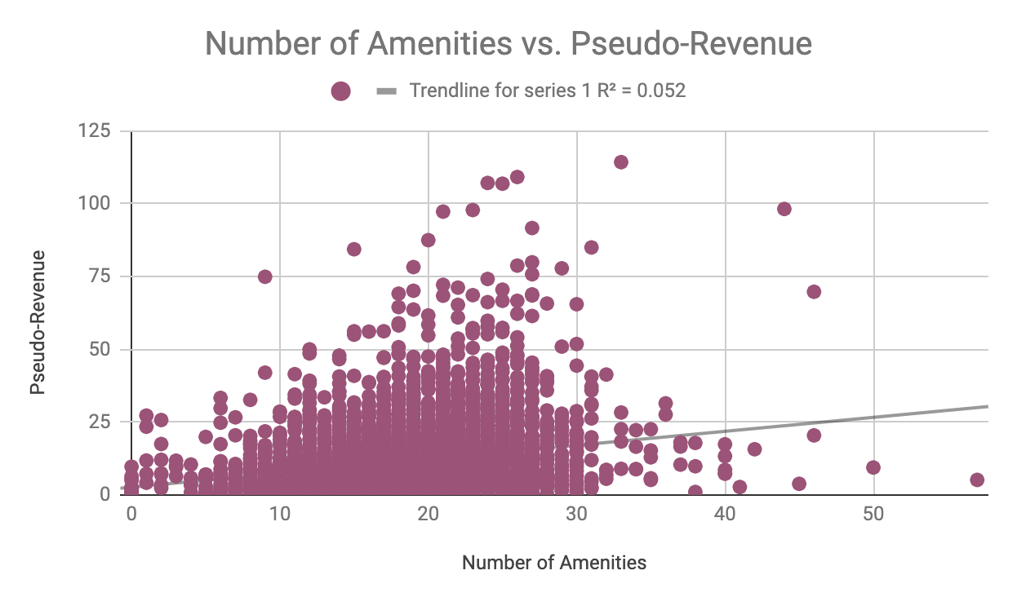
Provide a variety of Amenities
In the graph, notice the positive trendline between number of amenities and pseudo-revenue
Customers prefer to have a variety of amenities available to them at the listings
For our marketings campaign, the number of amenities proves to be an important trait amongst successful hosts

Slide 4
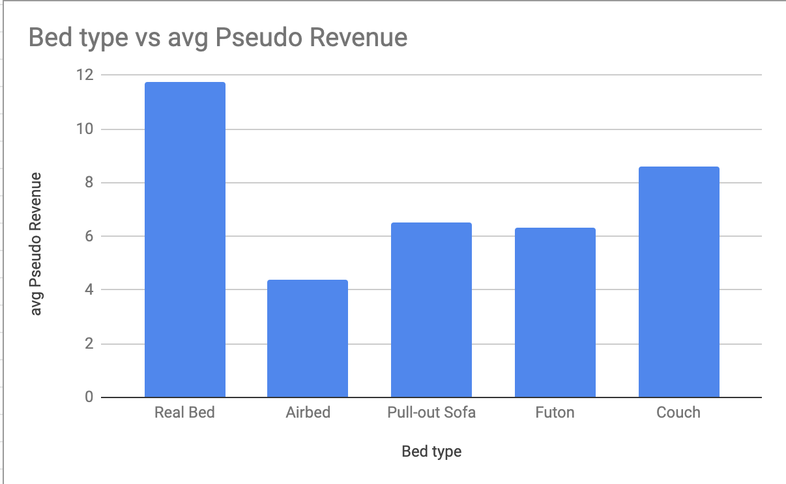
Use a real bed
In the graph, note the significant difference in average pseudo revenue in the different bed types
Customers prefer to sleep on real beds, and avoid listings with airbeds.
For our marketing campaign, a real bed type proves to be an important trait amongst successful hosts

Slide 5
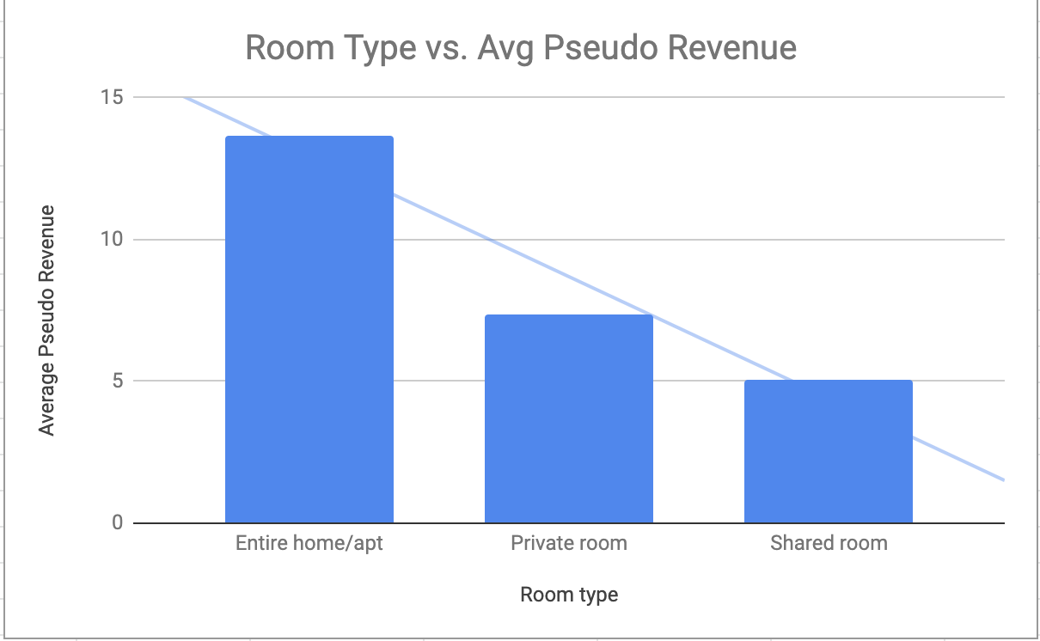
Provide the Entire home/apartment
In the graph, note the significant difference among room types
Customers prefer to have the entire listing to themselves
For our marketing campaign, the entire home/apt room type proves to be an important trait amongst successful hosts

Slide 6
Next Steps
Next, our team should work to create and release a guideline to prospective and current hosts in current locations as well as for our marketing campaign to expand to other cities.
In order to do so, we will need the contact information for all prospective and current Listings123 hosts

